Slide 1
Scam Alert System(SAS)

Slide 2
Abstract
The Scam Alert System is a web-based application designed to combat the rising threat of scams by providing users with real-time information and enabling administrators to manage scam data efficiently. It features a user-friendly interface for browsing scam details, categorized filters, and a robust admin panel for adding, editing, and deleting scam entries. Built with HTML, CSS, and JavaScript, the system integrates secure authentication to ensure user trust and data integrity. This project aims to raise awareness and protect individuals from fraudulent activities.

Slide 3
Introduction
Scams, such as online fraud, phone scams, and dating scams and many scams have become increasingly prevalent, causing financial and emotional harm.
The Scam Alert System is developed to educate and empower users by providing a centralized platform to access scam-related information.
It offers two interfaces: a user view for browsing scams and an admin panel for managing content.
Key features include search functionality, category filters, and secure login/logout mechanisms.

Slide 4
problem statement
Lack of accessible, centralized platforms to track and report scams.
Users often fall victim to scams due to insufficient awareness and delayed updates.
Manual scam reporting and management processes are inefficient and prone to errors.
Need for a secure, user-friendly system to authenticate users and allow admins to update scam data in real time.

Slide 5
System requirments
Hardware:
Processor: Minimum 1 GHz or higher
RAM: 4 GB or more
Storage: 500 MB free space
Internet connection for API calls
Software:
Operating System: Windows/Linux/Mac
Web Browser: Chrome, Firefox, Edge (latest versions)
Development Tools: Visual Studio Code or any text editor
Backend (assumed): Node.js, Express (for API endpoints like /api/scams)
Database (assumed): MongoDB or any RESTful database for storing scam data

Slide 6

Existing System
Current systems include scattered websites, forums, or government portals with limited interactivity.
Lack of real-time updates and user-friendly interfaces.
No dedicated admin control for managing scam data dynamically.
Authentication is often weak or absent, risking user data security.
Example: Static scam awareness pages with no search or filter options.

Slide 7
Proposed System
A dynamic web application with user and admin interfaces.
Real-time scam data management with CRUD (Create, Read, Update, Delete) operations for admins.
Secure login/register system with password reset via OTP.
Searchable and filterable scam list for users by category (e.g., online, phone, dating).
Responsive design for accessibility across devices.

Slide 8
Methodology flow diagram or architecture and technologies used
Technologies Used:
Frontend: HTML5, CSS3, JavaScript
Styling: Poppins font, custom CSS with transitions and media queries
Backend (assumed): Node.js, Express.js
Database (assumed): MongoDB or JSON-based
Storage Authentication: JWT(JSON Web Tokens) for secure token management

Slide 9
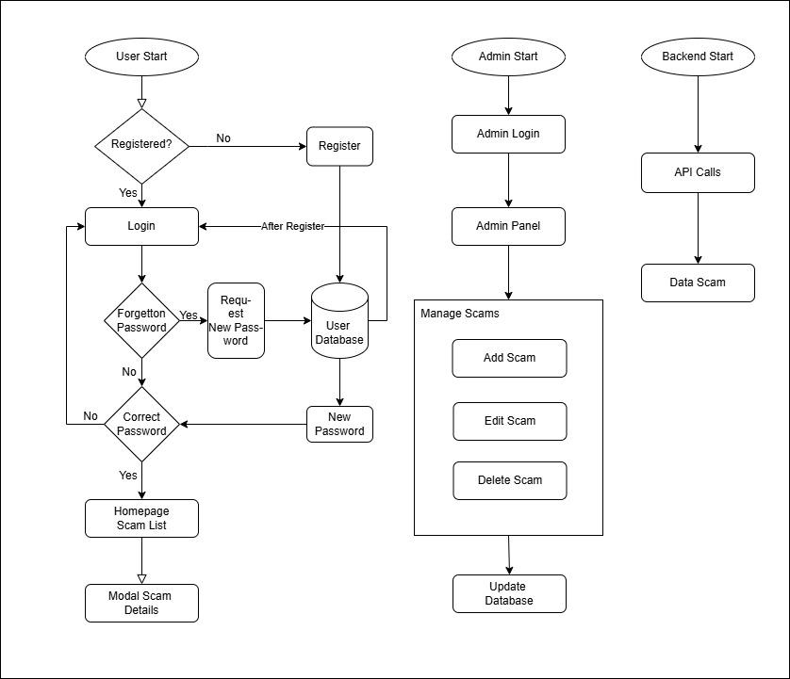
methodology flow diagram or architecture

Slide 10
Implemetation
Design Phase: Created wireframes for login, user homepage, and admin panel.
Frontend Development: Built responsive UI using HTML/CSS/JavaScript with modal popups and filters.
Backend Integration: Connected to API endpoints (/api/scams, /api/login) for data fetching and user authentication.
Functionality:
User: Fetch scams, filter by category, search with highlighting, view details in modal.
Admin: Add/edit/delete scams, populate dropdown for editing.
Testing: Validated login, scam CRUD operations, and responsiveness across devices.

Slide 11
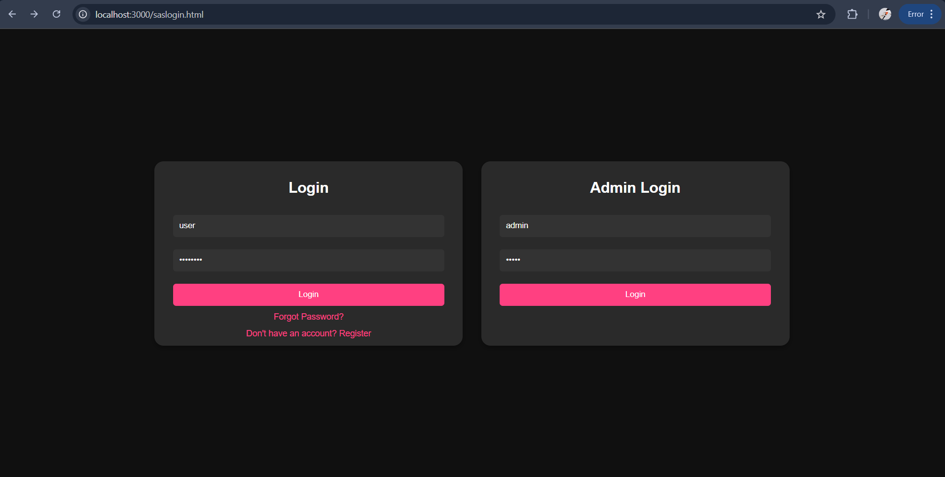
Result output screens
Login
page:

Slide 12
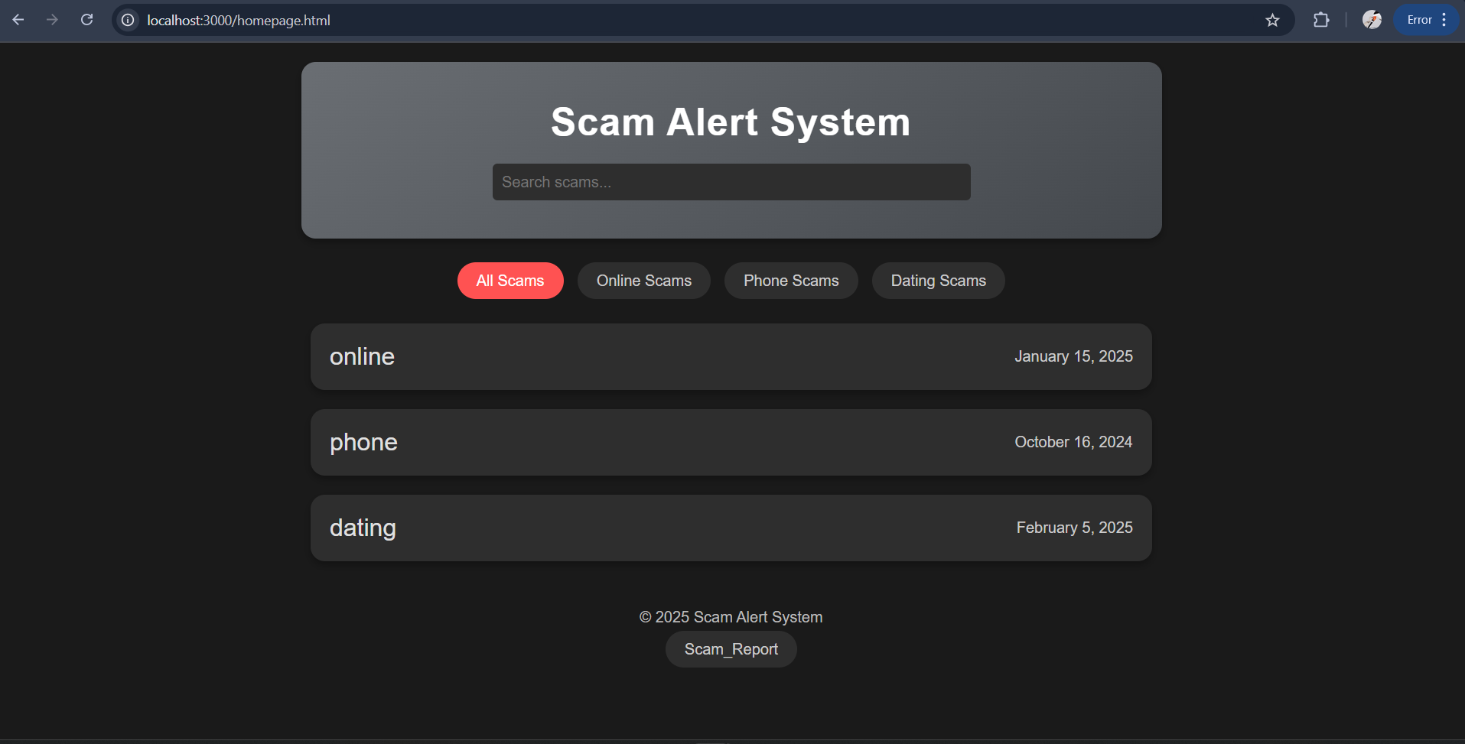
User page:

Slide 13
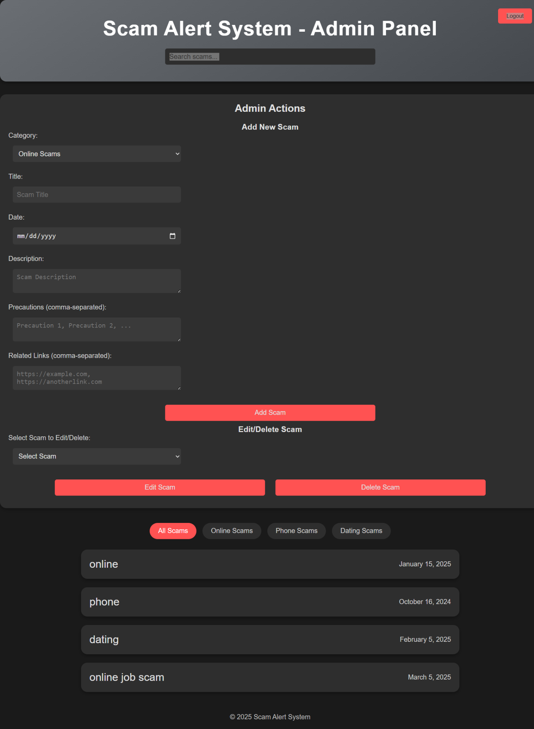
Admin page:

Slide 14
Advantages & limitations
Advantages:
User-friendly interface with search and filter options.
Secure authentication with password reset functionality.
Real-time scam updates by admins.
Responsive design for mobile and desktop use.
Limitations:
Requires internet connectivity for API calls.
No offline mode or local scam storage.

Slide 15
Conclusion
The Scam Alert System successfully provides a platform to raise awareness and manage scam data efficiently.
It bridges the gap between users and administrators with a secure and intuitive interface.
Future enhancements could include mobile app support, AI-based scam detection, and multilingual options.
This project contributes to reducing scam-related incidents by empowering users with knowledge.

Slide 16
Thank you!

